Slide 1

Padding Oracle On Downgraded Legacy Encryption (POODLE) Attack
Presented by: Loke Yong Jian
Lim Dong Wan

Slide 2
POODLE Attack Overview
Allow the attacker to decrypt the ciphertext and obtain the original text
Exploit a flaw in SSL 3.0 vulnerability : CVE-2014-3566
4 main components of POODLE Attack:
XOR Operation
Block Cipher (CBC Mode)
PKCS #7 Padding Standard
Oracle
Notes:
Non-deterministic:
Cannot determine actual padding value in original plaintext while the attacker is trying to brute-force the ciphertext byte-by-byte
Can only check if padding value is valid based on the number of occurrences of padding bytes, not the actual padding value in the original plaintext

Slide 3
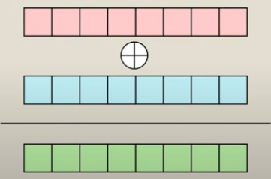
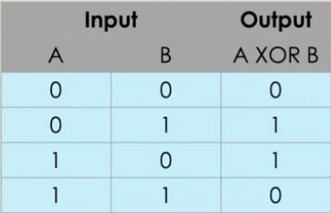
Weaknesses
Lack of strict padding validation
PKCS #7 standard: Appends bytes indicating the padding length (e.g., 02 02 for 2 bytes of padding ; 03 03 03 for 3 bytes of padding).
Does not validate against the actual padding byte value in the original plaintext
Cipher Block Chaining (CBC) Mode Characteristics
CBC mode introduces block interdependence, where each ciphertext block depends on the plaintext of the previous block.
Peculiar XOR Property
We only need 2 pieces of information to get the last piece of information
A XOR B = C
A XOR C = B
XOR operation is done byte-by-byte, bit-by-bit

Slide 4


Cipher Block Chaining
Ciphertext Block 1
Ciphertext Block 2
Ciphertext Block 3
Block Cipher Decryption
Block Cipher
Decryption
Block Cipher
Decryption
Key
Key
Key
IV
Plaintext Block 1
Plaintext Block 2
Plaintext Block 3
I
L
O
V
E
C
R
Y
P
T
O
,
I
T
I
S
F
U
N
!

Slide 5
POODLE Attack
with code analysis

Slide 6
1st Iteration
Notes:
C8 xor D8 = 0x01
We can manipulate C8.
D8 must be something that xor with C8 to make P8 0x01.
So by brute forcing C8 to satisfy C8 xor D8 = 0x01, we can get D8 correctly

Slide 7

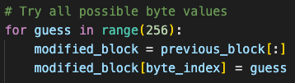
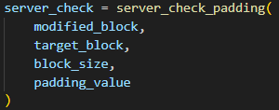
Attack Flow
Original C
4f
c1
C8
C - Original ciphertext
D - Decrypted text
P - Original plaintext
C
“Force” the last byte of P to be 0x01
Manipulate the last byte of C via brute-force:
Each byte will only have 2⁸ = 256 possibilities (00 to ff), which is very achievable
Brute-force until Oracle returns “valid padding”. Which means C8 xor D8 gives 0x01
Block Cipher Decryption
Key
D8
D
P8
Oracle
Invalid padding
01
P
Notes:
Force the last byte to be 0x01. We are not editing the last byte, just that we stop brute force when C8 xor D8 give 01.
C8 xor D8 = 0x01
We can manipulate C8.
D8 must be something that xor with C8 to make P8 0x01.
So by brute forcing C8 to satisfy C8 xor D8 = 0x01, we can get D8 correctly

Slide 8
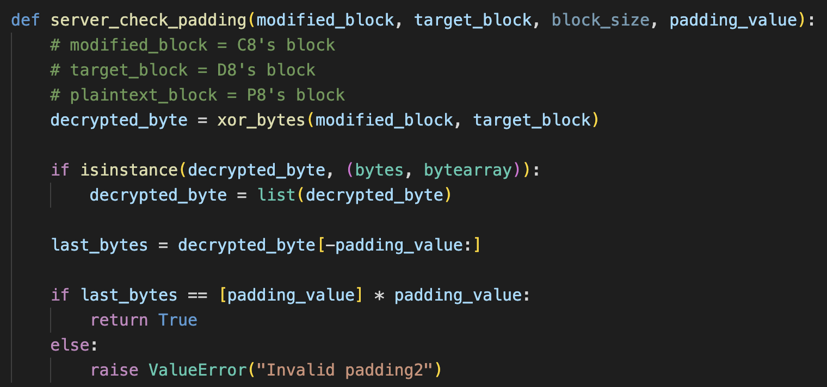
Oracle
Ciphertext
Oracle
Does the decrypted plaintext have valid padding?
Valid / Invalid

Slide 9
Attack Flow
Original C
4f
c1
C
c5
Block Cipher Decryption
Key
D
Oracle
Invalid padding
01
P
Notes:
C8 xor D8 = 0x01
We can manipulate C8.
D8 must be something that xor with C8 to make P8 0x01.
So by brute forcing C8 to satisfy C8 xor D8 = 0x01, we can get D8 correctly

Slide 10
Attack Flow
Original C
4f
c1
C
c6
Block Cipher Decryption
Key
D
Oracle
Invalid padding
01
P
Notes:
C8 xor D8 = 0x01
We can manipulate C8.
D8 must be something that xor with C8 to make P8 0x01.
So by brute forcing C8 to satisfy C8 xor D8 = 0x01, we can get D8 correctly

Slide 11

Attack Flow
Original C
4f
c1
C
c7
D8 = c6
Block Cipher Decryption
Equation to get D8:
D8 xor C8 = 0x01
D8 xor C8 xor C8 = 0x01 xor C8
D8 xor 00 = 0x01 xor C8
D8 = 0x01 xor C8
C8 = c7
So, D8 = 0x01 xor c7
D8 = c6
Key
D
c6
Oracle
Valid padding
01
P
Notes:
C8 xor D8 = 0x01
We can manipulate C8.
D8 must be something that xor with C8 to make P8 0x01.
So by brute forcing C8 to satisfy C8 xor D8 = 0x01, we can get D8 correctly

Slide 12
Attack Flow
Original C
4f
c1
C
c7
D8 = c6
C8 = c7
Block Cipher Decryption
Equation to get P8:
P8 xor C8 = c6
P8 xor C8 xor C8 = c6 xor C8
P8 xor 00 = c6 xor C8
P8 = c6 xor C8
C8 = c1 (original C)
So, P8 = c6 xor c1
P8 = 07
Key
D
c6
Oracle
Invalid padding
07
P
Notes:
C8 xor D8 = 0x01
We can manipulate C8.
D8 must be something that xor with C8 to make P8 0x01.
So by brute forcing C8 to satisfy C8 xor D8 = 0x01, we can get D8 correctly

Slide 13
2nd Iteration
Notes:
C8 xor D8 = 0x01
We can manipulate C8.
D8 must be something that xor with C8 to make P8 0x01.
So by brute forcing C8 to satisfy C8 xor D8 = 0x01, we can get D8 correctly

Slide 14
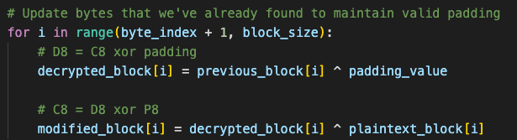
Attack Flow
Original C
4f
c1
C
c4
D8 = c6
C8 = c7
Block Cipher Decryption
Modify C8 such that C8 xor D8 = 02
So, C8 = D8 xor P8
= c6 xor 02
= c4
Key
D
c6
Oracle
Invalid padding
02
P
Notes:
C8 xor D8 = 0x01
We can manipulate C8.
D8 must be something that xor with C8 to make P8 0x01.
So by brute forcing C8 to satisfy C8 xor D8 = 0x01, we can get D8 correctly

Slide 15
Attack Flow
Original C
4f
c1
C
X
c4
D8 = c6
C8 = c7
Block Cipher Decryption
We repeat the same operations, which is to brute-force C7 such that:
C7 xor D7 = 02
Key
D
c6
Oracle
Invalid padding
02
02
P
Notes:
C8 xor D8 = 0x01
We can manipulate C8.
D8 must be something that xor with C8 to make P8 0x01.
So by brute forcing C8 to satisfy C8 xor D8 = 0x01, we can get D8 correctly

Slide 16
Attack Flow
Original C
4f
c1
C
4a
c4
D8 = c6
C8 = c7
D7 = 48
Block Cipher Decryption
Equation to get D7:
D7 xor C7 = 0x02
D7 xor C7 xor C7 = 0x02 xor C7
D7 xor 00 = 0x02 xor C7
D7 = 0x02 xor C7
C7 = 4a
So, D7 = 0x02 xor 4a
D7 = 48
Key
D
48
c6
Oracle
Valid padding
02
02
P
Notes:
C8 xor D8 = 0x01
We can manipulate C8.
D8 must be something that xor with C8 to make P8 0x01.
So by brute forcing C8 to satisfy C8 xor D8 = 0x01, we can get D8 correctly

Slide 17
Attack Flow
Original C
4f
c1
C
4a
c4
D8 = c6
C8 = c7
D7 = 48
C7 = 4a
Block Cipher Decryption
Equation to get P7:
P7 xor C7 = 48
P7 xor C7 xor C7 = 48 xor C7
P7 xor 00 = 48 xor C7
P7 = 48 xor C7
C7 = 4f (original C)
So, P7 = 48 xor 4f
P7 = 07
Key
D
48
c6
Oracle
Invalid padding
07
07
P
Notes:
C8 xor D8 = 0x01
We can manipulate C8.
D8 must be something that xor with C8 to make P8 0x01.
So by brute forcing C8 to satisfy C8 xor D8 = 0x01, we can get D8 correctly

Slide 18
Attack Outcome
Original C
ca
2d
c0
b6
8c
e6
4f
c1
Block Cipher Decryption
Key
D
d4
2a
c7
b1
8b
e1
48
c6
Raw Plaintext
HMAC
HMAC
07
07
07
07
07
07
07
P
Notes:
C8 xor D8 = 0x01
We can manipulate C8.
D8 must be something that xor with C8 to make P8 0x01.
So by brute forcing C8 to satisfy C8 xor D8 = 0x01, we can get D8 correctly

Slide 19

Attack Simulation
Disclaimer:
We are not actually communicating through real servers and ports; instead, we are using the session state cookie function in Python’s Streamlit to pass data between the components.

Slide 20
Mitigation - Encrypt-then-MAC
Encrypt-then-MAC approach is more secure than MAC-then-Encrypt:
Encrypt-then-MAC | MAC-then-Encrypt
Encrypt original plaintext → Compute Message Authentication Code (MAC) of plaintext | Compute Message Authentication Code (MAC) of original plaintext → Encrypt plaintext
Verify MAC of original plaintext → Decrypt received ciphertext | Decrypt received ciphertext → Verify MAC of original plaintext
Attackers can neither modify the MAC nor the ciphertext to get the plaintext. | Attackers can modify the ciphertext and brute-force against the padded bytes of the original plaintext.

Slide 21
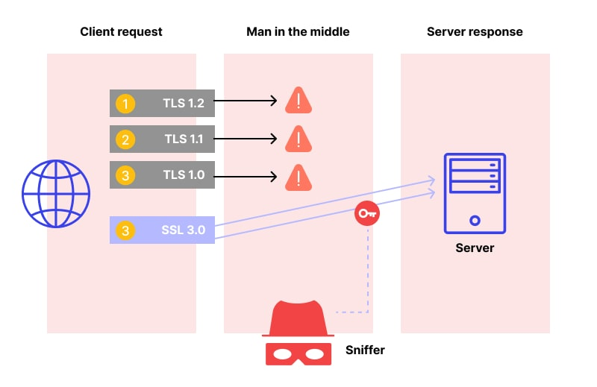
Mitigation - Disable SSL 3.0 Completely
Disable SSL 3.0 completely on both client browsers and servers:
Adopt the latest TLS version that both parties can support
Notes:
https://www.wallarm.com/what/poodle-attack

Slide 22

Conclusion
Understanding the fundamentals of cryptography is crucial in identifying and mitigating software vulnerabilities effectively.
Foundational knowledge empowers us to evaluate and enhance the security of systems, as highlighted by the POODLE attack, which underscores the importance of cryptographic literacy in uncovering and addressing such vulnerabilities.

Slide 23


Thanks!

Slide 24
Table of contents
01
02
03
04
05
POODLE Attack Overview
Attack Flow (with Code Analysis)
Attack Simulation
Mitigation
Conclusion

Slide 25
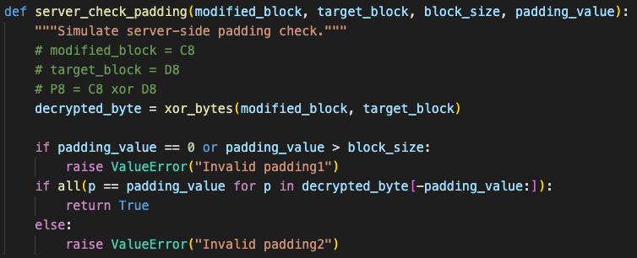
Oracle
Ciphertext
Oracle
Does the decrypted plaintext have valid padding?
Valid / Invalid

Slide 26
Block Cipher
Ciphertext Block 1
Ciphertext Block 2
Ciphertext Block 3

Slide 27

Padding Standard: PKCS #7
C
O
C
O
N
U
T
\01
O
R
A
N
G
E
\02
\02
A
P
P
L
E
\03
\03
\03
PKCS #7 padding adds padding bytes with values equal to the number of padding bytes.

